Slide 1

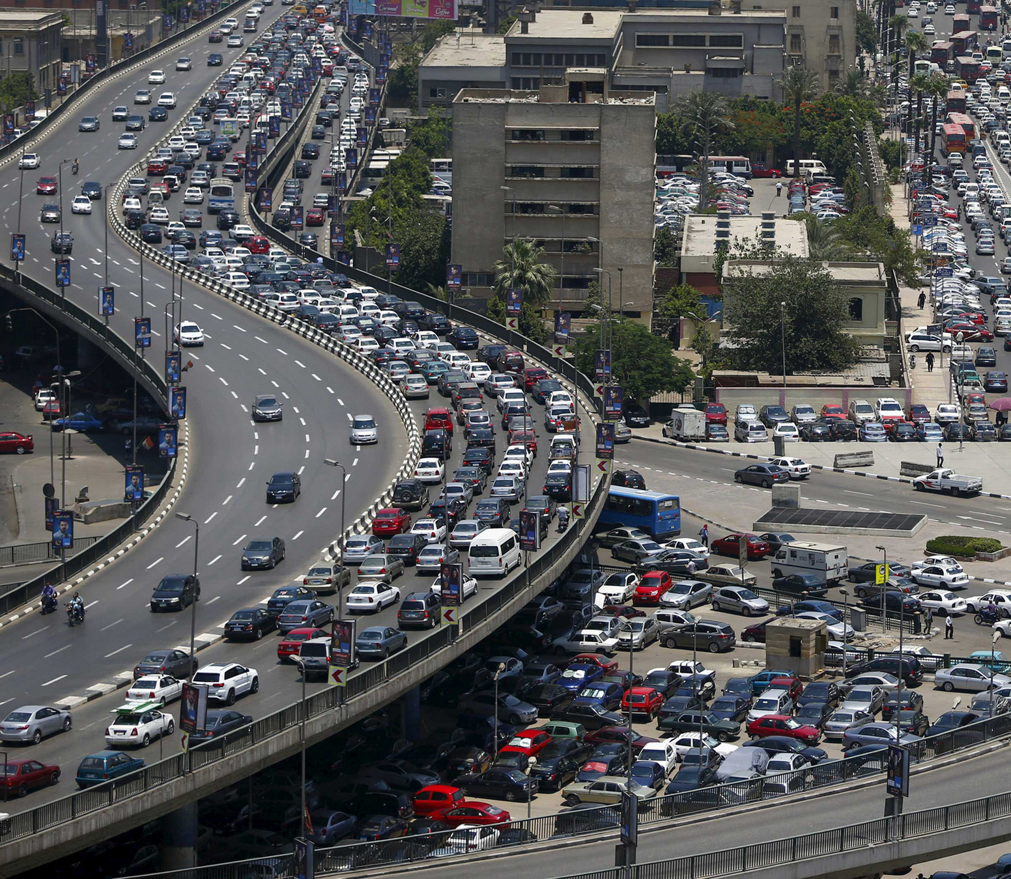
Ain Shams University
Faculty of Computer & Information Science
Information Systems Department
METROBAS
Transportation Application

Slide 2


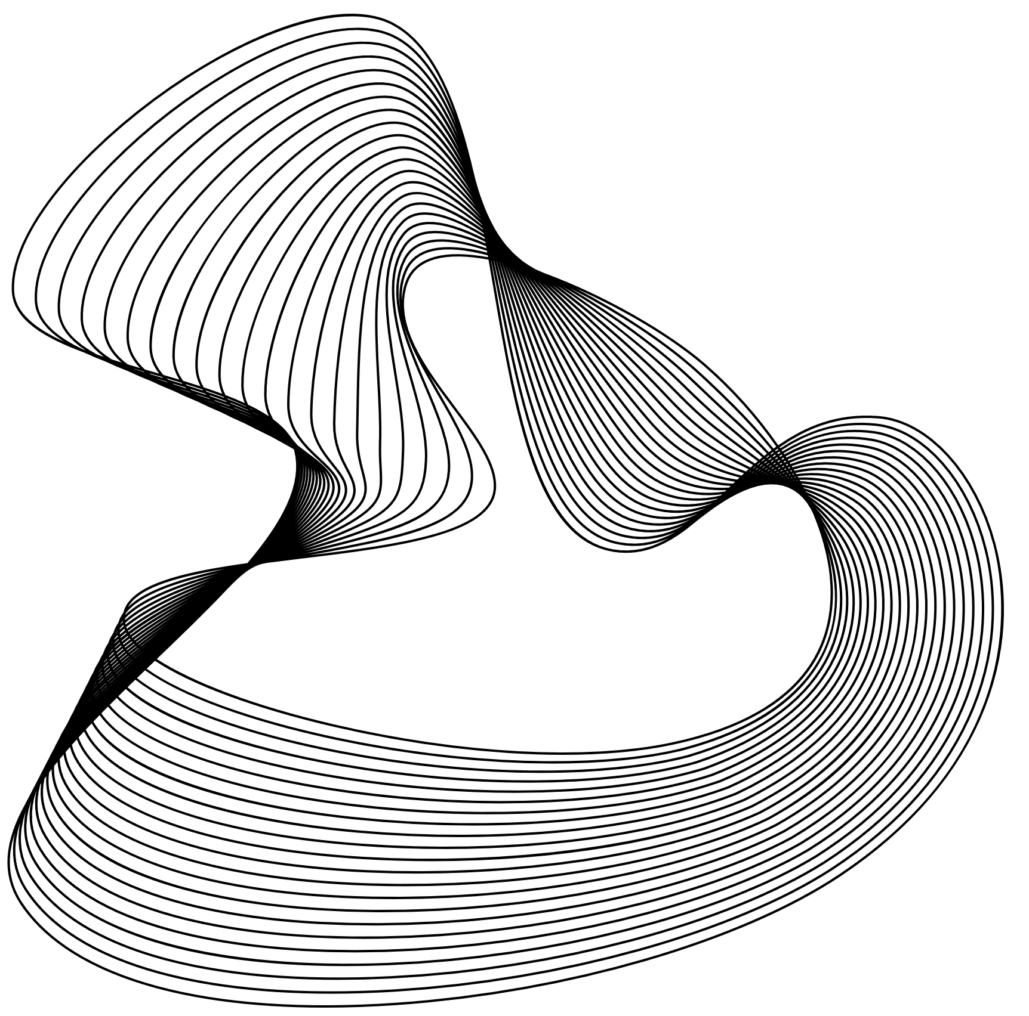




Our Management Team
Abdelrahman Salah Abdelmawgoud
Aya Allah Mahmoud Abdelhady
Abdelrahman Mahmoud Mohamed Saker
Aya Mohamed Fouad Ali
Ahmed Adel Ibrahim Basiony
Salah-eldeen Hossam Mohamed
DR. Mahmoud Mounir
TA. Reham Ashraf

Slide 3

Agenda
Introduction
Challenges
Objective
Dataset & Result
Related work
Algo & Techniques
Architecture
Demo
List of functions
Conclusion

Slide 4
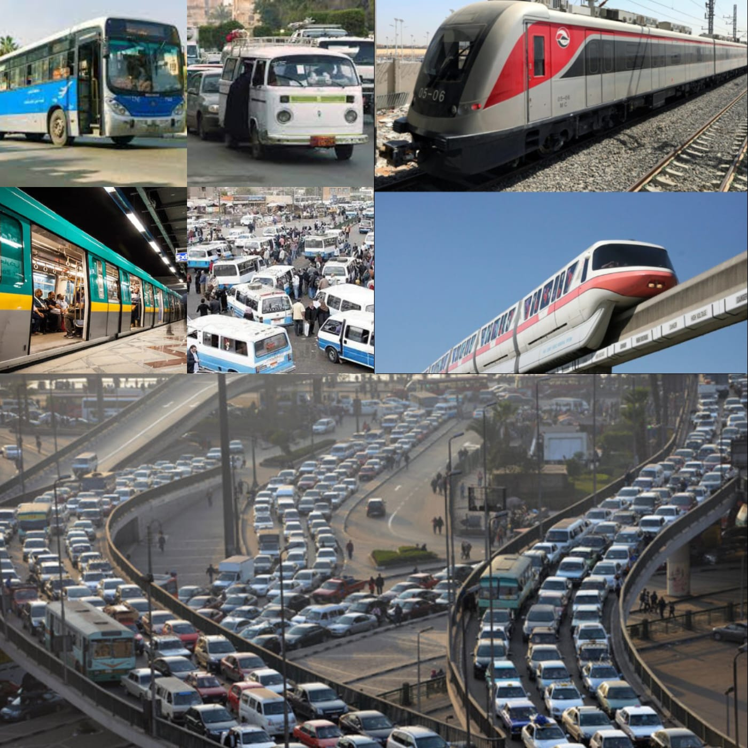
Introduction
Egypt has a vast transportation
network, with significant
developments such as
monorails and electric trains.
Many Egyptians depend on using various types
of public transportation in their daily lives.The latest statistics in 2019 indicate that there are
only 3.2 million subway users daily.

Slide 5
Problem definition

Slide 6
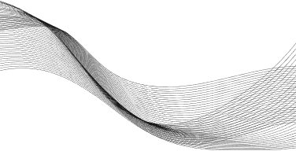
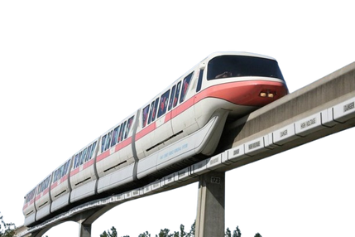
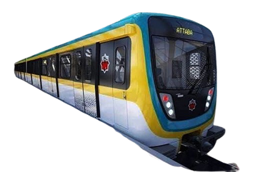
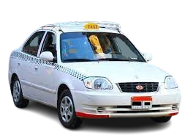


Objective
"Metrobas" is a user-friendly mobile app that
helps users in Egypt choose the best public transportation routes based on their preferences, such as cost, time, or transfers, ensuring an enhanced commuting experience.
ensures correct information

Slide 7
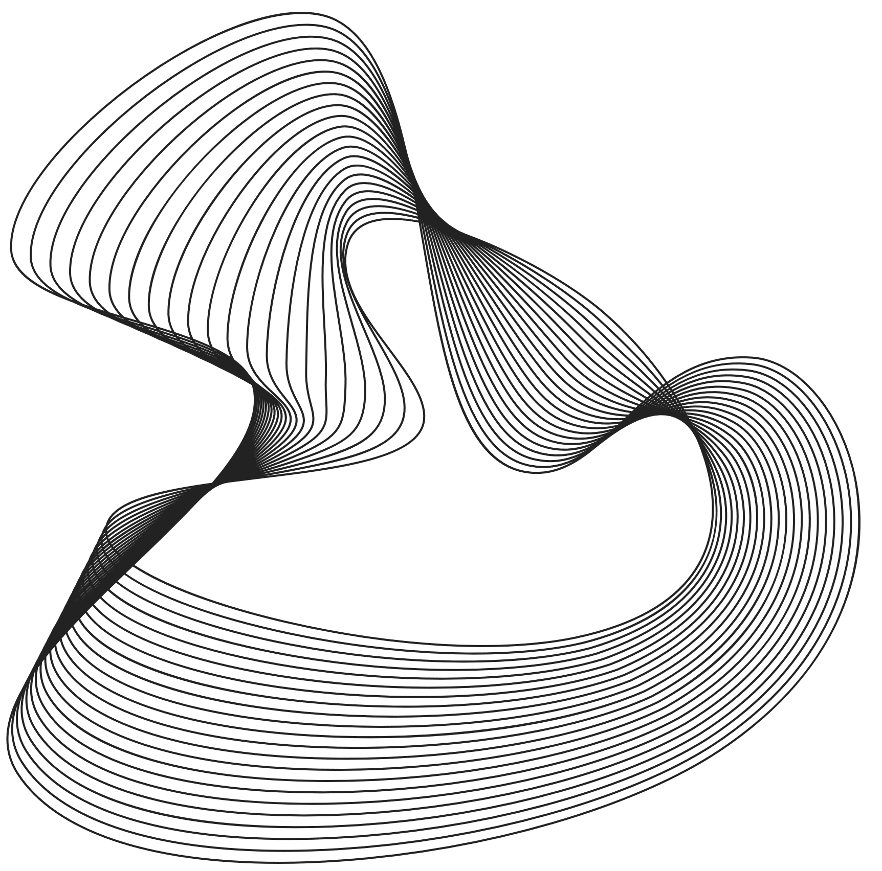


Related Works ( Systems)
 | MOOVIT | Transit | Arkab Eh | Wasalni | Cairo Metro | Google Maps | Metrobas
In Egypt (Arabic)
Availability of all means of transportation
The Data up to date
Having a map showing the route
Taking user preferences to trip

Slide 8

What is new?

Slide 9

How the user can choose the path he wants to take?

Slide 10
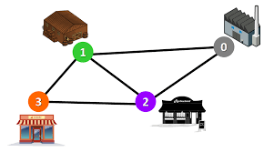

How the user can choose the path he wants to take?
S
D
Lowest time

Slide 11
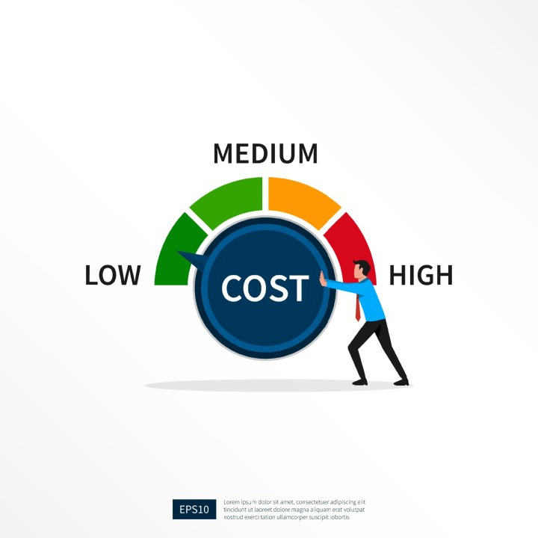
How the user can choose the path he wants to take?
S
D
Lowest time
less lowest cost

Slide 12
How the user can choose the path he wants to take?
minimum number of transportations

Slide 13

How the user can choose the path he wants to take?
minimum number of transportations
shortest distance walking

Slide 14



System Architecture
Application Layer
logic layer
Data Layer
Presentation Layer
Security System
(Authentication &
Authorization)
Reporting Service
user
input and output
Public Transit Routing Service
GTFS data
Chat Service
Map
services
User data

Slide 15
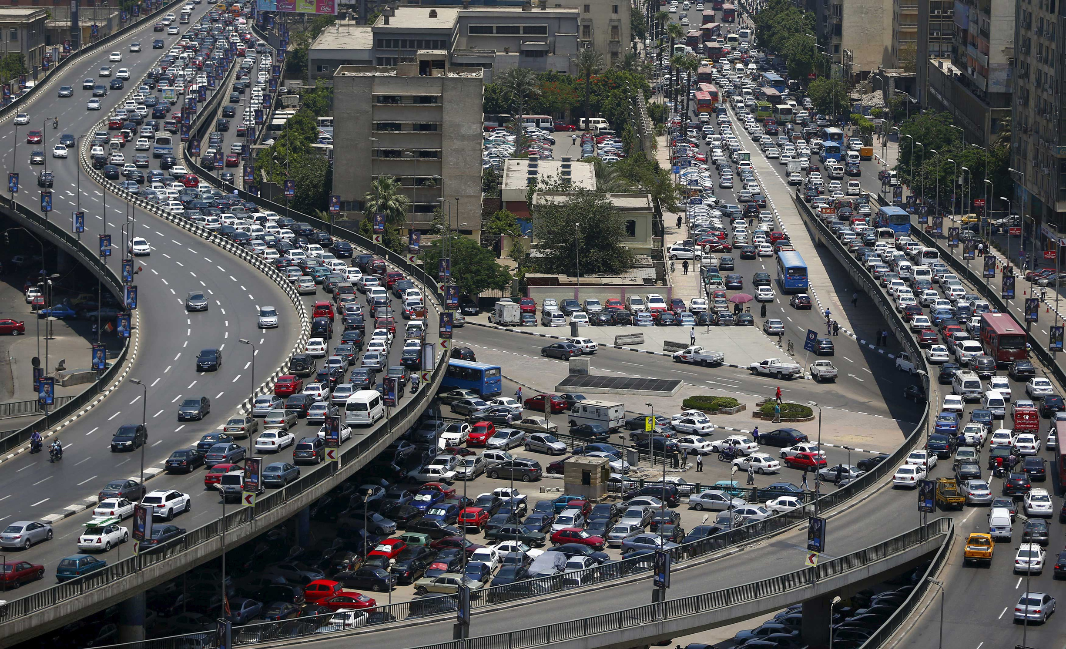
List of functions
Register &login
Select saved stations
Choose source and destination stations
Select transportation type
Number of transportations filter
Cost filter
Time & distance filter
distance walking filter

Slide 16
List of functions
Display all routes
Display route details
Show the route on the map
Chat with other people
Chat messages report
Report
Logout

Slide 17


Slide 18

Challenges
Data Challenges

Slide 19

Challenges
Data Challenges
Routing Algorithm Challenges

Slide 20

Data Challenges

Slide 21


Data problems
Incomplete data
Missing of some features, such as information on bus and minibus prices.
Absence of some stations, such as the newly metro stations opened third line.
Absence of some transportation, such as the new electric train.
The data is not up to date.

Slide 22
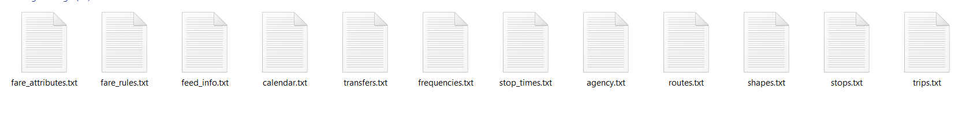
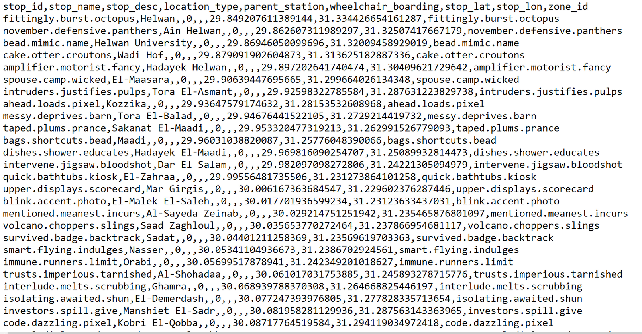
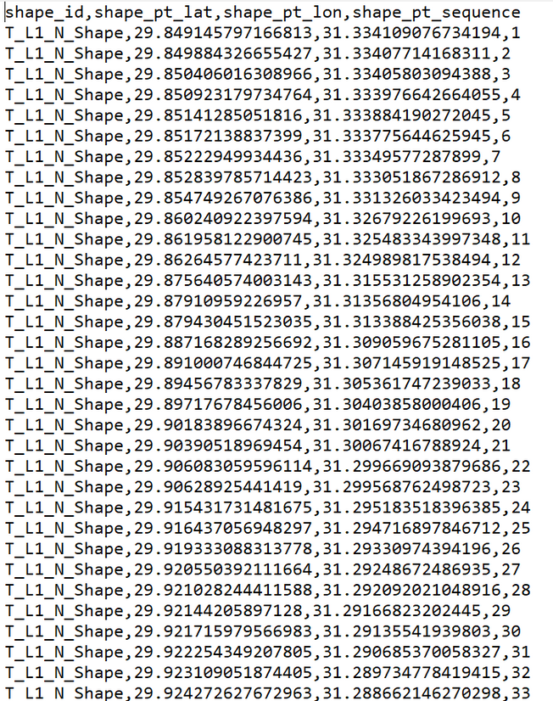
Solutions Steps

Slide 23
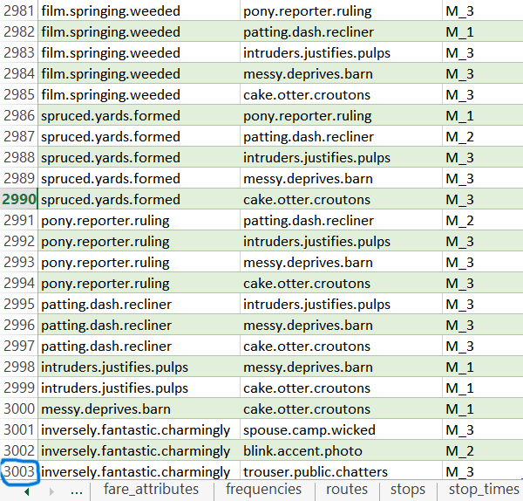
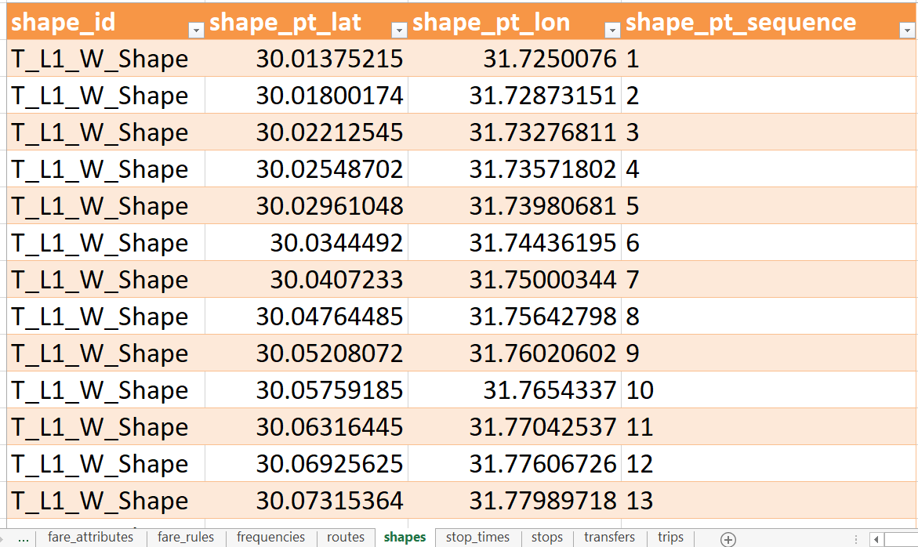
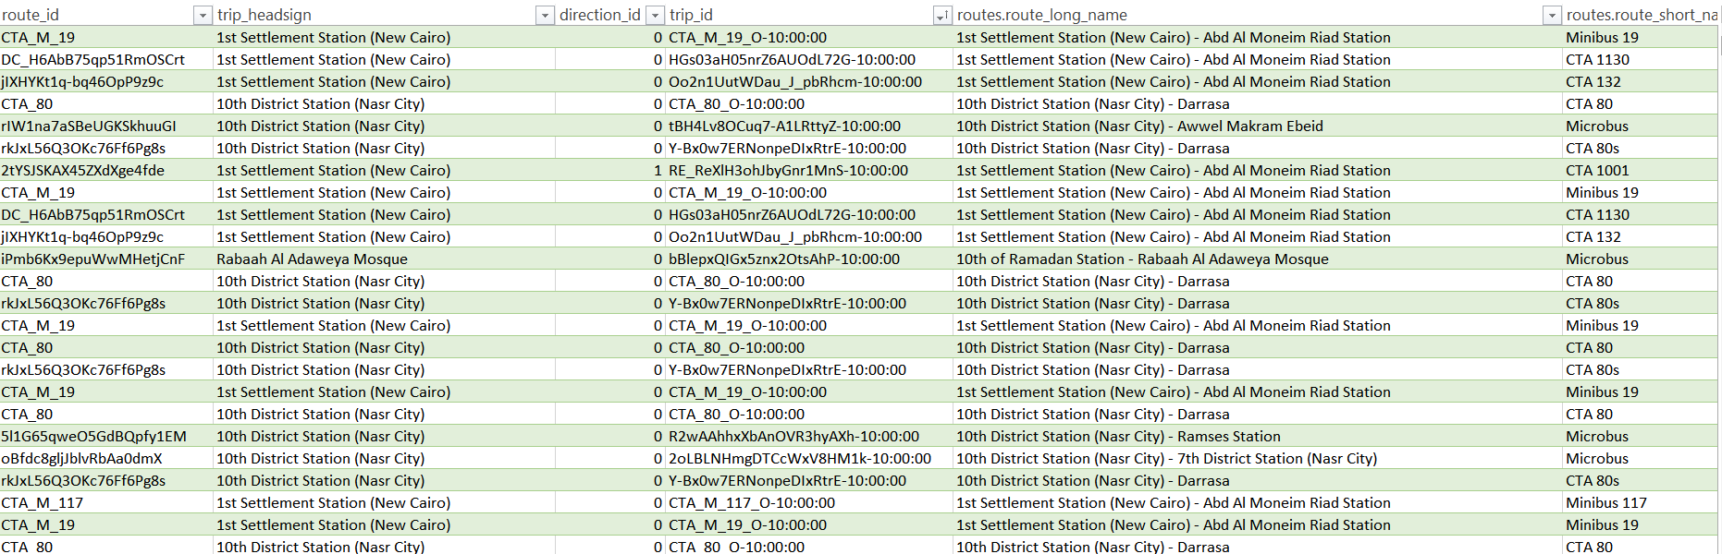

Slide 24
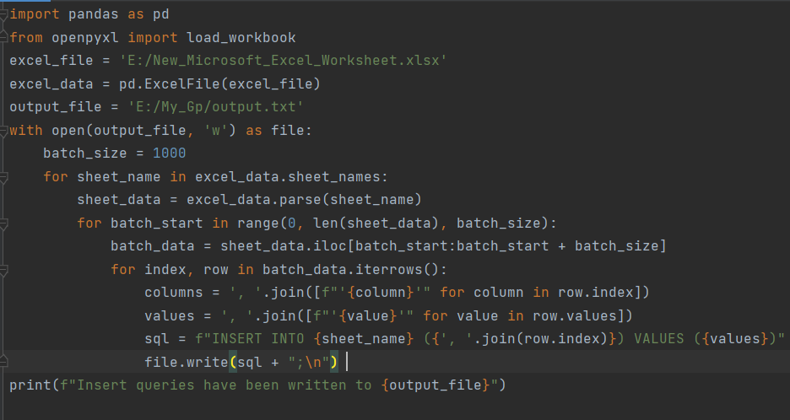

Slide 25
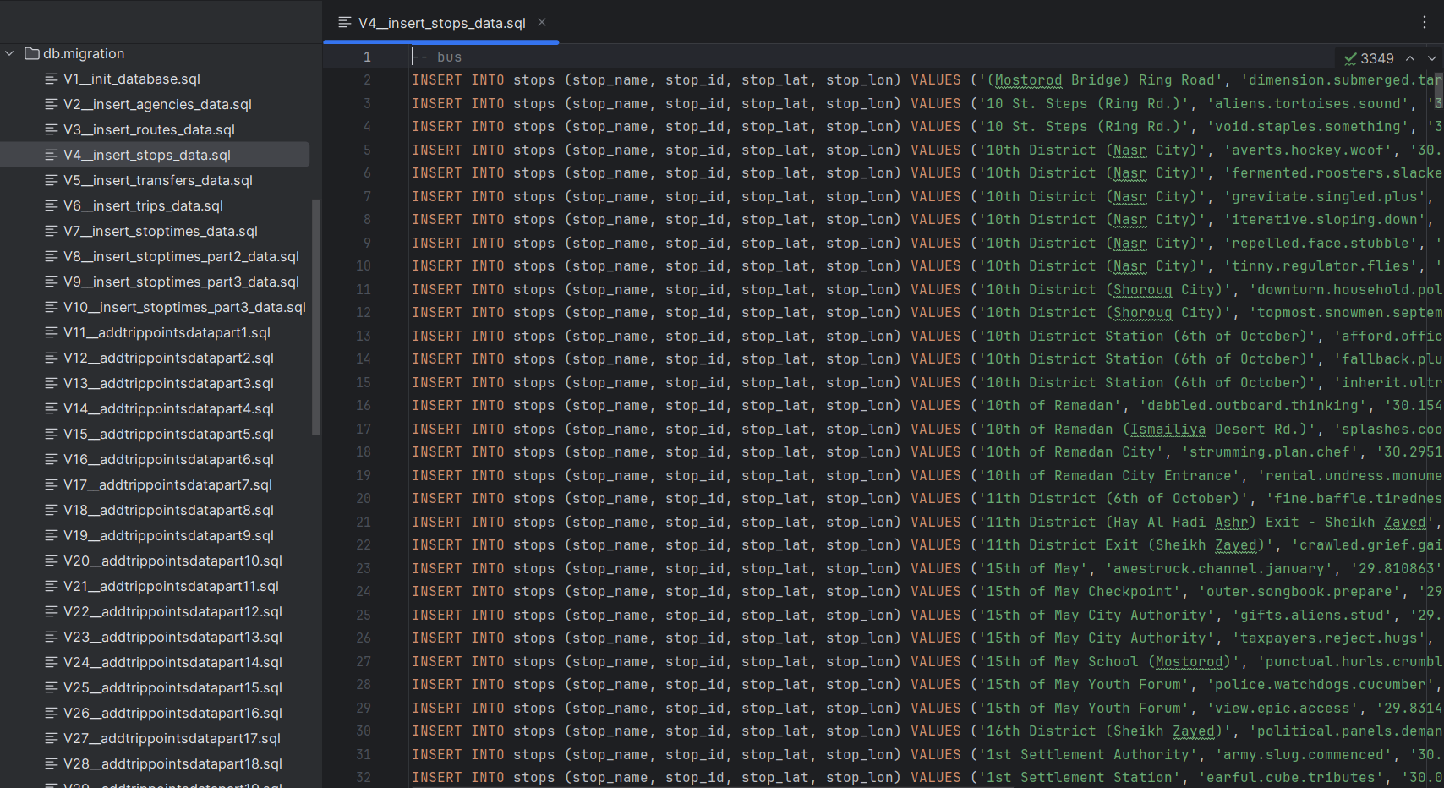

Slide 26
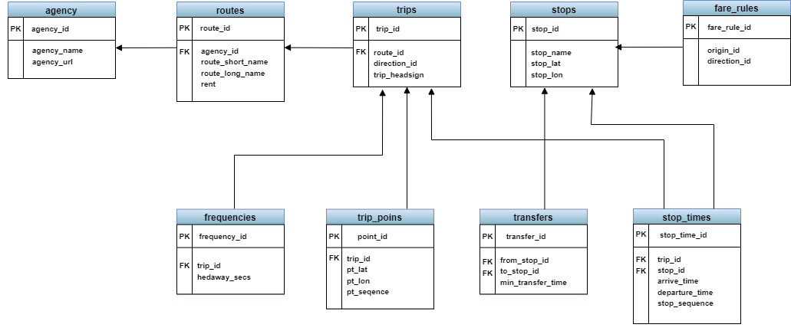
Finally
GTFS Schema

Slide 27
Routing Algorithm Challenges

Slide 28
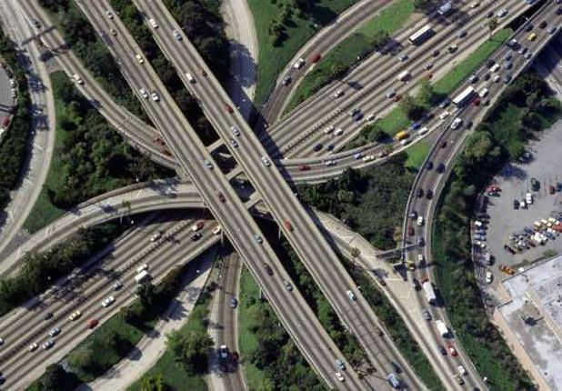
Public Transit Routing Algorithm
We initially implemented Dijkstra's algorithm for route optimization.
However, we found that its solution wasn't optimal.
We then explored alternative algorithms until we found RAPTOR.
Implementing RAPTOR provided accurate and reliable results for our routing needs.

Slide 29

Algorithms & Techniques
A
6 min
5 LE
3 min
5 LE
C
time
2 min
B
4 min
5 LE
D
trip | time | number of transfers | price
A -> B ->D
7 min
2
10 LE
A -> C ->D
8 min
1
5 LE

Slide 30

Algorithms & Techniques
A
6 min
1 - Dijkstra's algorithm
5 LE
3 min
5 LE
C
time
2 min
B
4 min
5 LE
D
trip | time | number of transfers | price
A -> B ->D
7 min
2
10 LE
A -> C ->D
8 min
1
5 LE

Slide 31
Algorithms & Techniques
A
6 min
2 - RAPTOR algorithm
5 LE
3 min
5 LE
C
time
2 min
B
4 min
5 LE
D
trip | time | number of transfers | price
A -> B ->D
7 min
2
10 LE
A -> C ->D
8 min
1
5 LE

Slide 32
Algorithms & Techniques
Dijkstra's algorithm | MC RAPTOR algorithm
When I try to get the shortest path in time it will show the A -> B -> D trip with minimum time ( 7 min ) but two transportation and 10 LE price while most of people will chose the second trip because the difference in time is 1 min but will provide number of transportations and cost of trip. | In RAPTOR algorithm will show all non dominates trip that no of them best then another trip in all filters critria and good with time tables data so in this example it will show the two trips and the user can choose and the application will arrange it based on the selected filter
50 ms | 300 ms
Finally, we choose the multi-model multi-criteria RAPTOR algorithm as it gives more efficient results

Slide 33

DEMO

Slide 34
Conclusion
In conclusion, "Metrobas" aims to revolutionize the public transportation experience for Egyptians. By offering a personalized and efficient way to plan journeys, the app addresses the daily challenges faced by commuters. With features that cater to various preferences, Metrobas not only simplifies route selection but also enhances overall satisfaction with public transportation. This innovation is a step forward in leveraging technology to improve urban mobility, ultimately contributing to a more efficient and user-friendly public transportation system in Egypt.

Slide 35

Future works

Slide 36
Future works
We look forward to completing the data to include transportation for the entire governorates and villages of Egypt.

Slide 37
Future works
We look forward to completing the data to include transportation for the entire governorates and villages of Egypt.
We intend to integrate with Google Maps to make our map Interactive.

Slide 38
Future works
We look forward to completing the data to include transportation for the entire governorates and villages of Egypt.
We intend to integrate with Google Maps to make our map Interactive.
We look forward to adding a machine learning model for auto detection in chat about fake news, offensive words, political topics, and so on.

Slide 39





Software Tools
Frontend
Backend

Slide 40


References
Szincsák, Tamás & Vágner, Anikó. (2015). Public transit schedule and route planner application for mobile devices. 153-161. 10.14794/ICAI.9.2014.2.153 http://icai.ektf.hu/icai2014/papers/ICAI.9.2014.2.153.pdf [1].
Setiawan, Esther & Gunawan, & Maryati, Indra & Santoso, Joan & Chandra, Rossy. (2012). Shortest Path Problem for Public Transportation Using GPS and Map Service. Procedia - Social and Behavioral Sciences. 57. 426–431. 10.1016/j.sbspro.2012.09.1207 [2].
Jakimavičius, Marius & Palevičius, Vytautas & Antucheviciene, Jurgita & Karpavičius, Tomas. (2019). Internet GIS-Based Multimodal Public Transport Trip Planning Information System for Travelers in Lithuania. International Journal of Geo-Information. 8. 319. 10.3390/ijgi8080319 https://www.mdpi.com/2220-9964/8/8/319 [3] .
Goldberg, Andrew & Harrelson, Chris. (2003). Computing the shortest path: A* search meets graph theory. Proceedings of the Annual ACM-SIAM Symposium on Discrete Algorithms. 10.1145/1070432.1070455 [4] .

Slide 41


References
Wang, Xiao. (2018). The Comparison of Three Algorithms in Shortest Path Issue. Journal of Physics: Conference Series. 1087. 022011. 10.1088/1742-6596/1087/2/022011 [5] .
MOOVIT . https://moovitapp.com/nycnj-121/poi/en [6] .
Transit . https://transitapp.com/ [7] .
ArakbEa . https://play.google.com/store/apps/details?id=com.sa3dy.arkabeh&hl=ar&gl=US [8].
Wasalni . https://play.google.com/store/apps/details?id=com.semicolon.wassalni&hl=ar&gl=US [9] .
Cairo Metro. https://play.google.com/store/apps/details?id=metro.amateurapps.com.cairometro&hl=en_US [10] .
Google Transit. https://www.google.com/maps [11] .

Slide 42





Thank You

